Slide 1


Fire Physics
Modeling of wood fire dampened by a sprinkler system
By: Will Luik

Slide 2
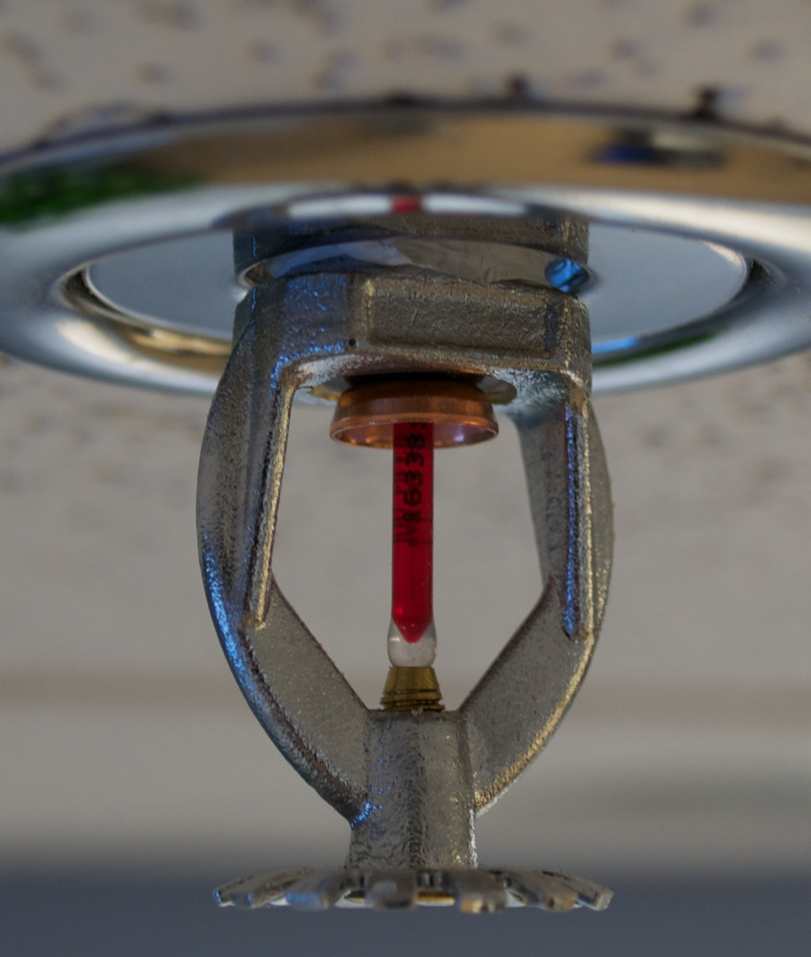
Motivation
Everyday applications
Fire science is a forgotten subfield
Why not

Slide 3
Model Description
The code is split into 5 separate files
Mother file
Projectile motion of a droplet
Ising model
Sprinkler projection
Plotting
Most structured with arrays

Slide 4
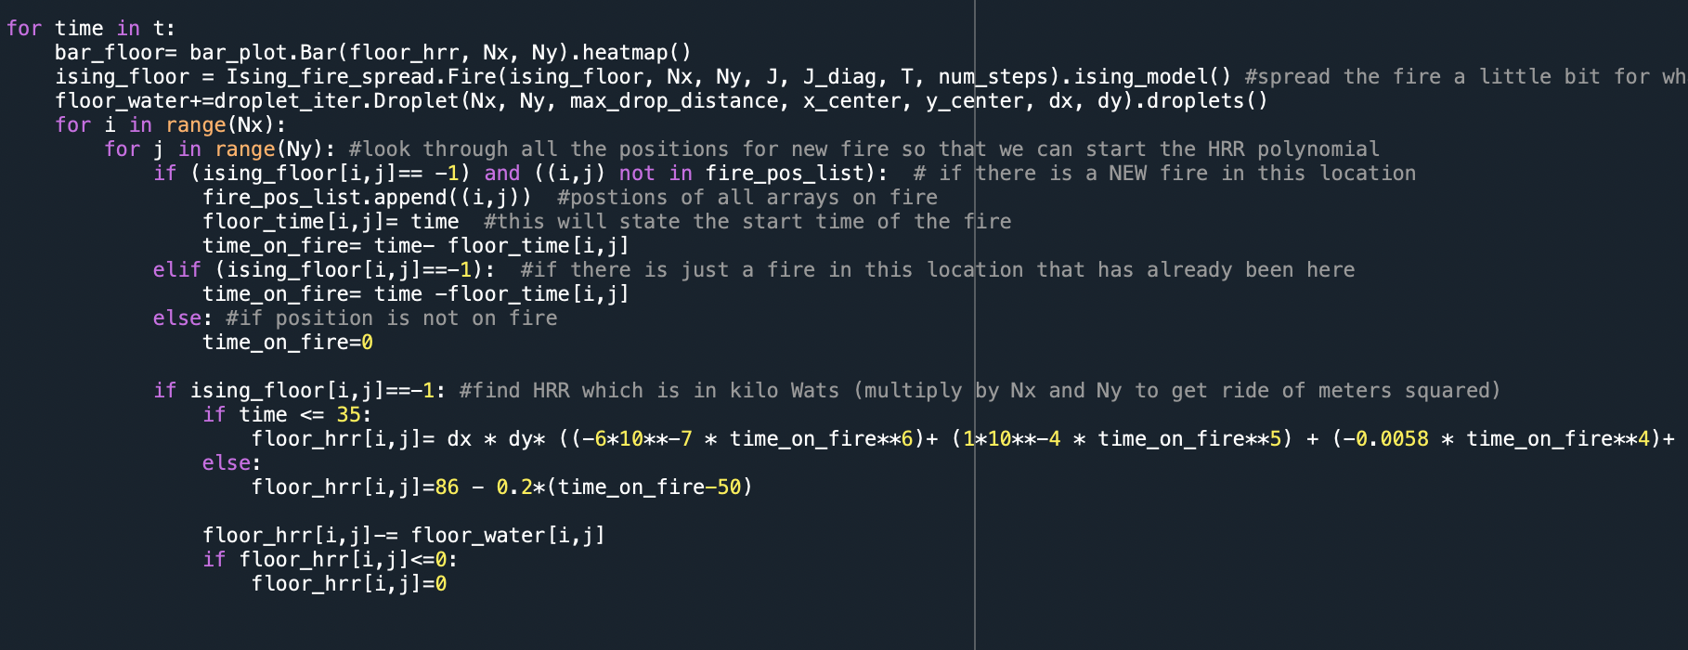
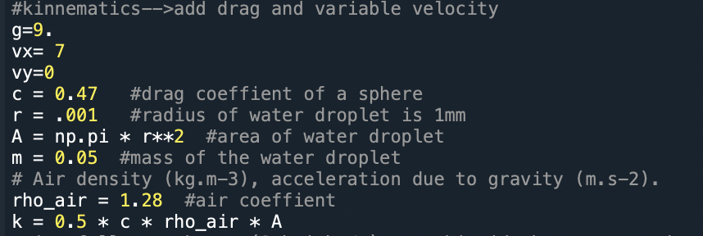
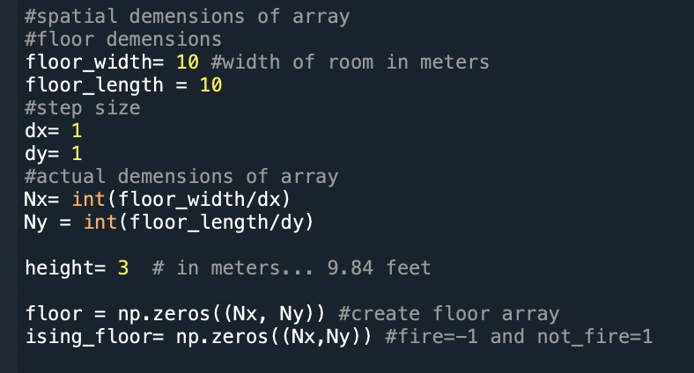
Main File
Initialize arrays
Initial conditions/ parameters
Driving iterator

Slide 5
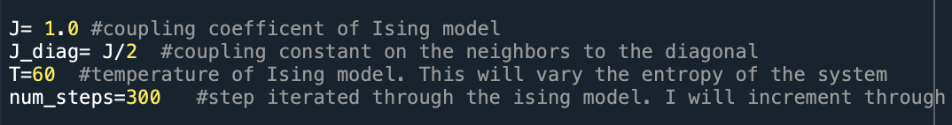
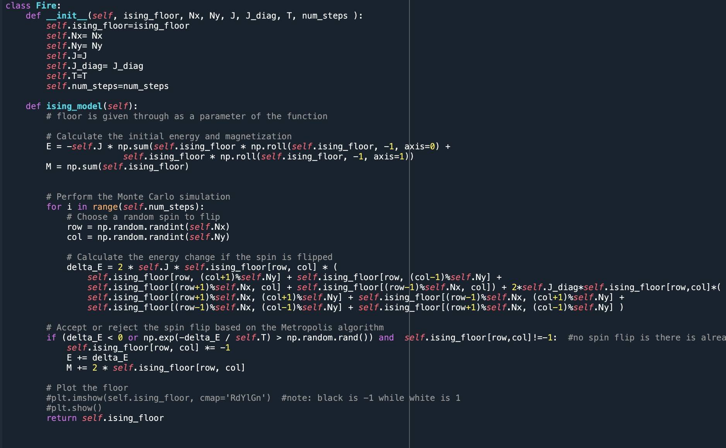
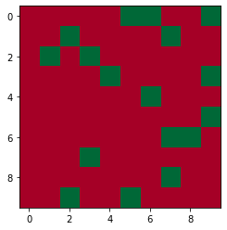
Ising Model
Diagonal Coupling
Can only turn to fire
Iterated 300 steps every second

Slide 6
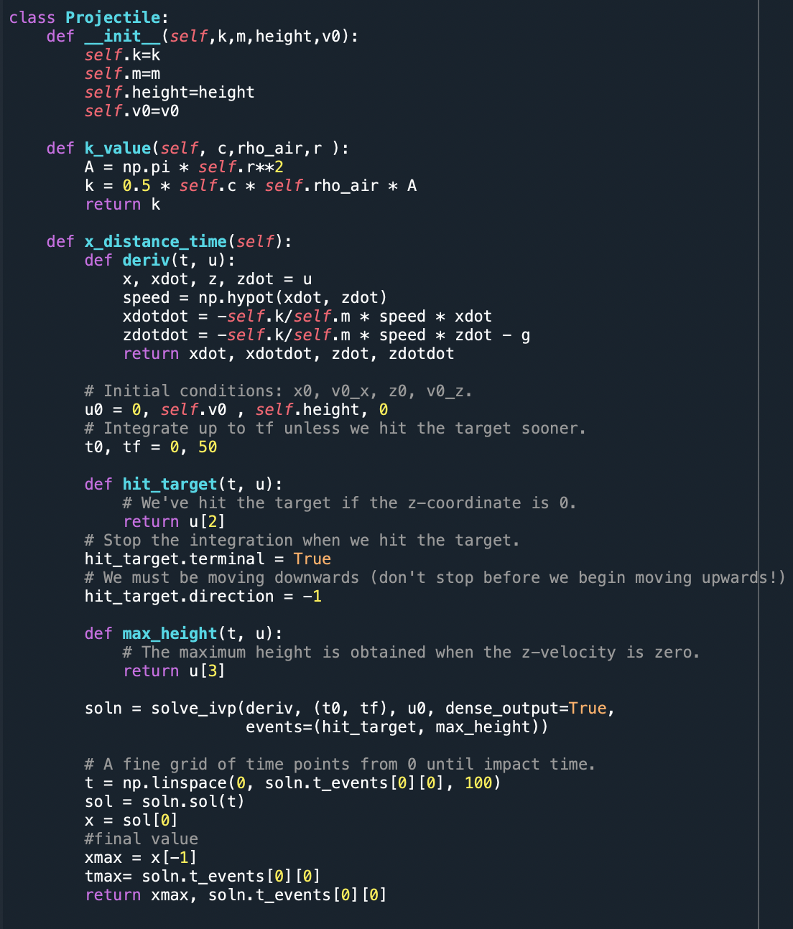

Projectile Motion
Accounts for air drag
Calculates maximum time and horizontal distance from a specified height

Slide 7
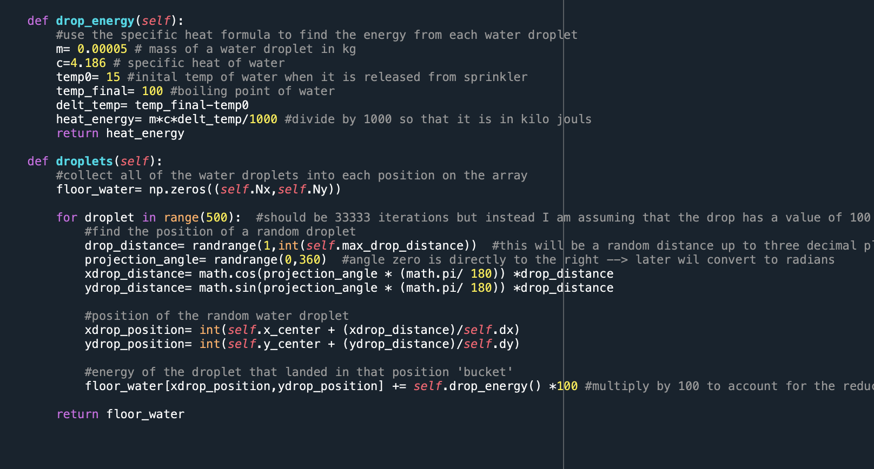
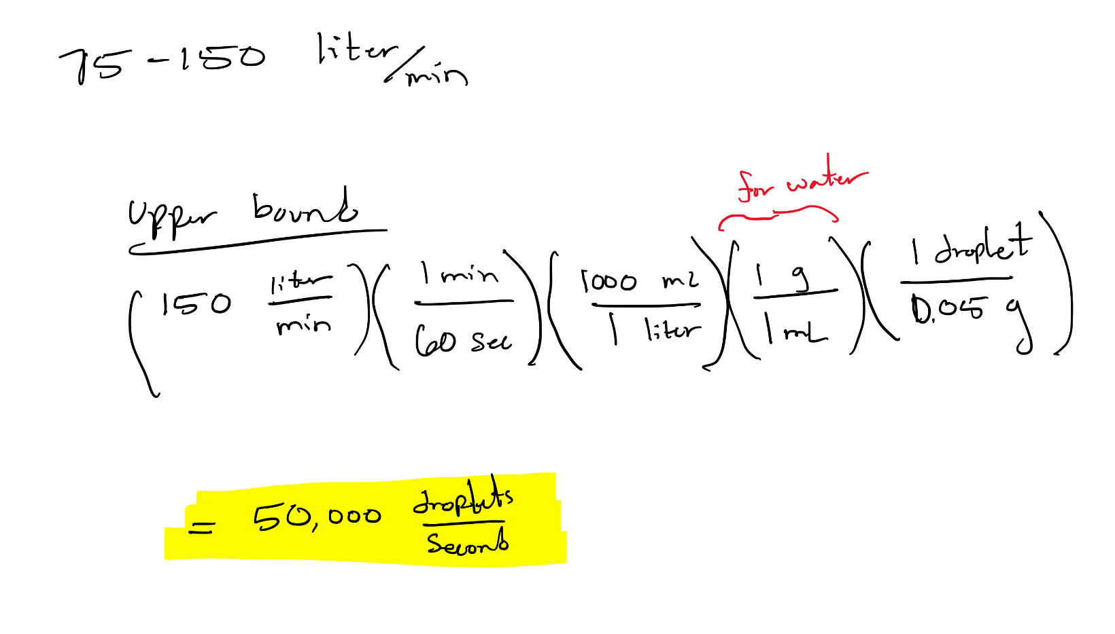
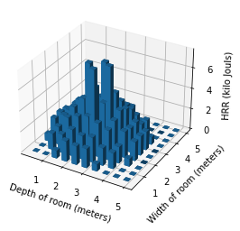
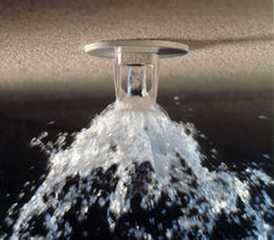
Droplet Iterator
Randomize droplet projection
Iterate through all droplets for each second

Slide 8
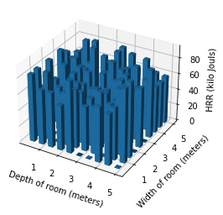
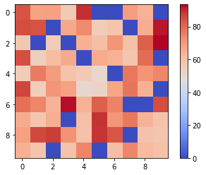
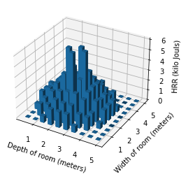
Plotter
Fire HRR
Heatmap
Bar plot
Water HRR

Slide 9
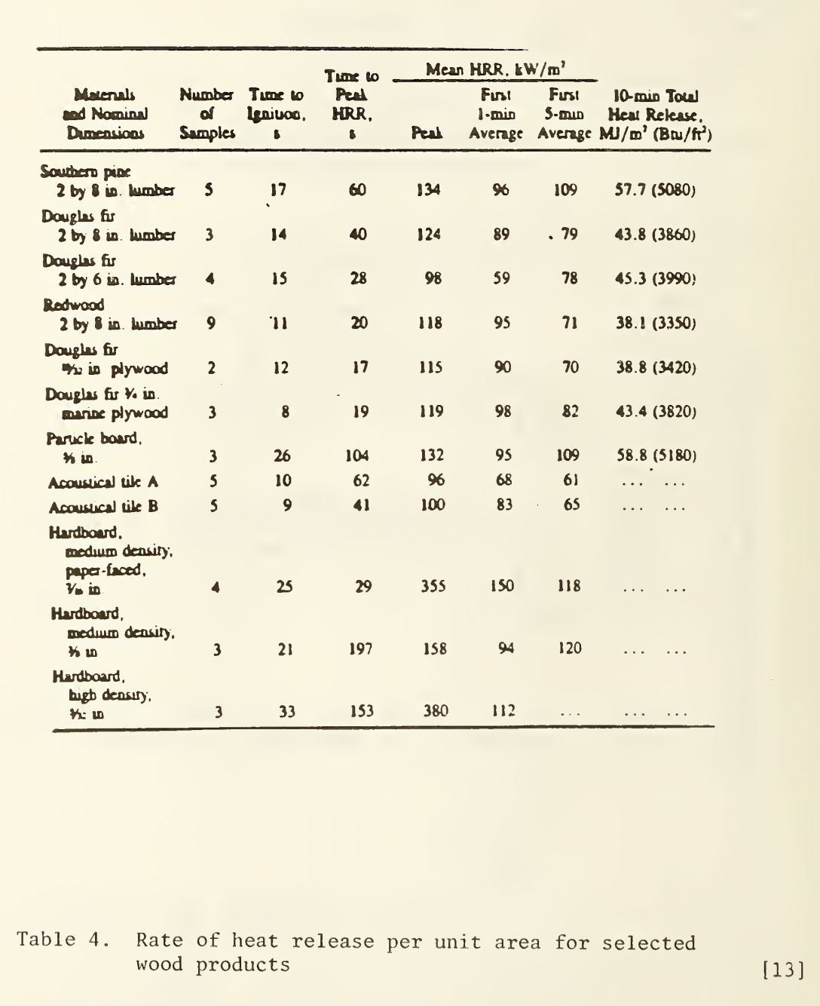
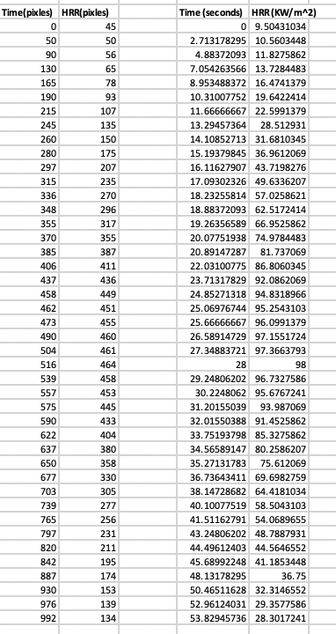
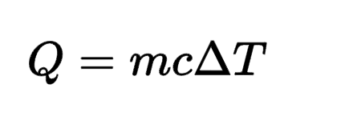
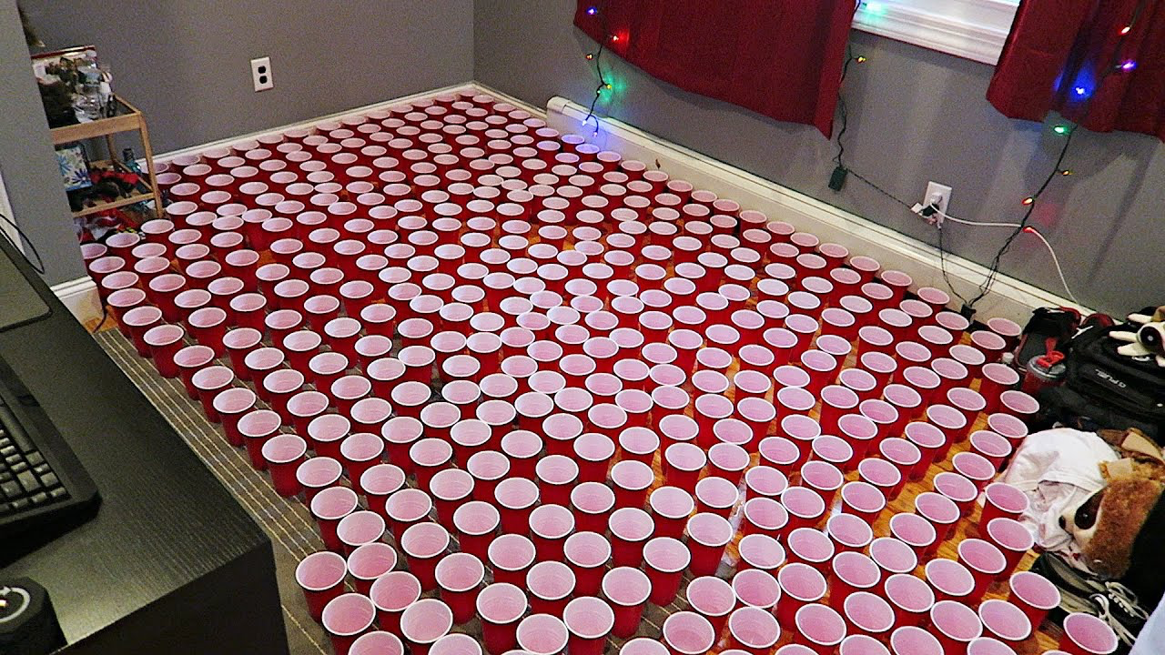
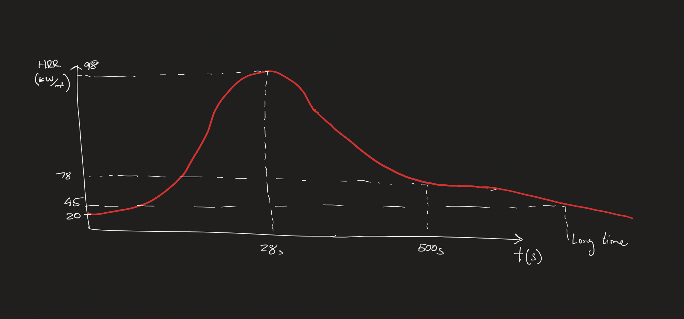
Math/Applications Used
HRR (KW/m^2)

Slide 10
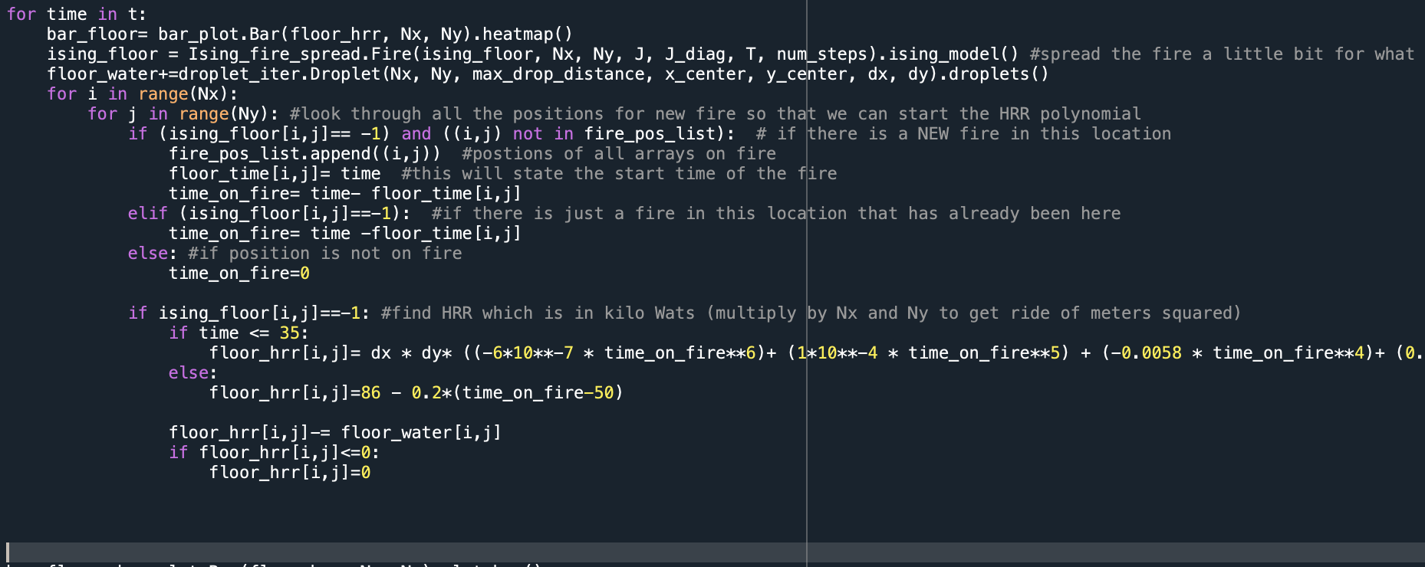
Describe the code

Slide 11
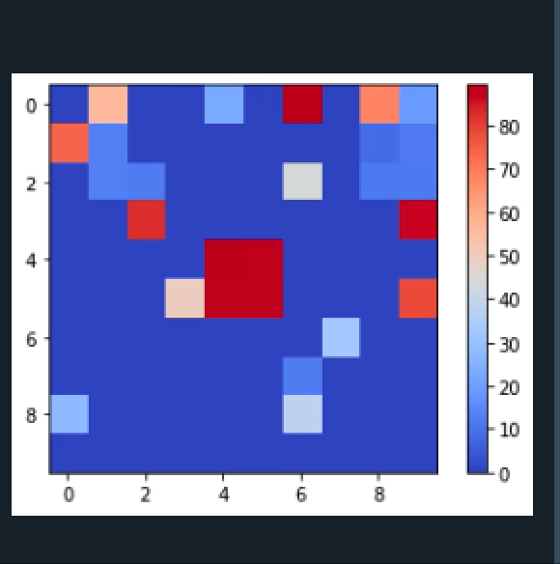
Results

Slide 12
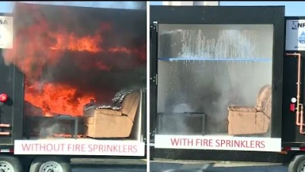
True Effect of Sprinkler

Slide 13
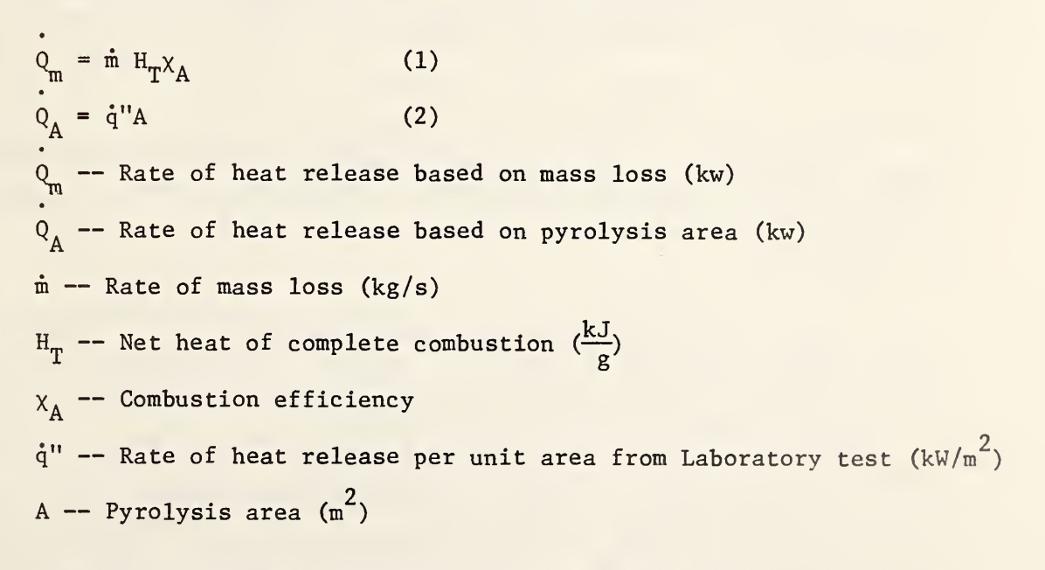

Conclusion/ Improvements
Decrease step size
Variability in floor layout
Different burning/water equation

